Slide 1
Adaptive predictive control for pipelined multiprocessor image-based control systems considering workload variations
Sajid Mohamed¹, Nilay Saraf², Daniele Bernardini³, Dip Goswami¹, Twan Basten¹, Alberto Bemporad²
¹Eindhoven University of Technology, The Netherlands
²IMT School for Advanced Studies, Lucca, Italy
³ODYS S.r.l., Italy
This research has received partial funding from the EU’s H2020 FP under GA no 674875 (oCPS) and the ECSEL JU under GA no 783162 (FitOptiVis).

Slide 2
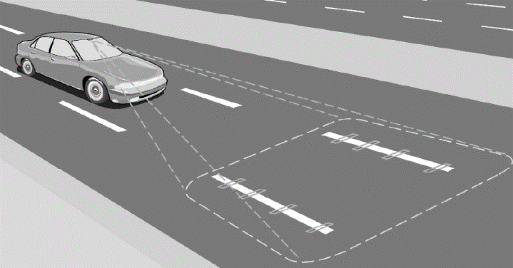
Image-based control (IBC) system – an example
S : Sensing & processing
camera(s)
C : Control computation
Dynamic system (continuous time)
A : Actuation
Vision-based lateral control of a vehicle
Embedded Platform (discrete-time)
Embedded Platform
vehicle on road
disturbance
Control Strategies
steering angle
desired lateral
lateral deviation
deviation $r$
$$u[k]$$
$$y[k]$$
$$x[k]$$
measure states

Slide 3
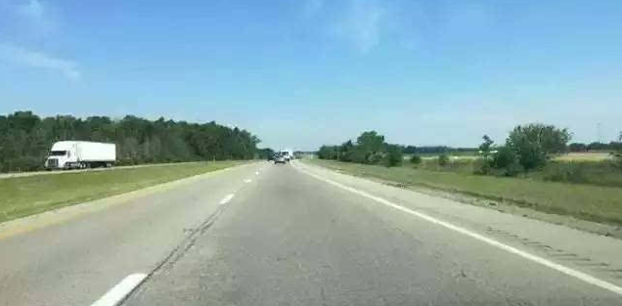
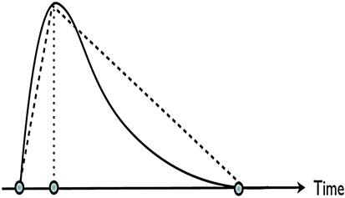
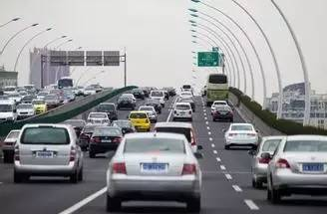
IBC system characteristics: workload variations
workload distribution
best-case
worst-case
S
C
idle time
A
S
C
idle time
A
S
C
A
Execution time of ‘S’ depends on image workload variations
Variable relatively long sensing delay
Do not know the exact sequence of occurrence of image workload apriori

Slide 4
IBC system: typical design
workload distribution
best-case
worst-case
rarely happens
S
C
idle time
A
S
C
idle time
A
S
C
A
$$kh$$
($k+1)h$
($k+2)h$
60 fps
$$f_{h}$$
τ$=h$
dropped frames
0
100
time (ms)
Controllers typically designed for worst-case workload → rarely happens
Dropped frames and unnecessary idle times

Slide 5
IBC system: research question
workload distribution
best-case
worst-case
S
C
idle time
A
S
C
idle time
A
S
C
A
How to cope with this long, variable sensing delay to improve system performance?

Slide 6
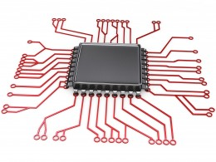
Multiprocessor IBC system
Multiprocessors are common and relatively cheap
Highly suitable for IBC system implementation
Pipelined implementation – focus of this work
Reduces sampling period
Maximal pipelined implementation: when h = f_{h}
$$k$$
$$k+1$$
$$k+2$$
$$k+3$$
$k+4$
$$k+5$$
camera input
$$f_{h}$$
τ
Core 3
C
A
S
C
A
S
C
A
Core 2
C
A
S
C
A
S
C
A
...
Core 1
S
C
A
S
C
A
time
$$y(k)$$
$$y(k+1)$$
$$y(k+2)$$
$$y(k+3)$$
$$y(k+4)$$
$$y(k+5)$$

Slide 7
Multiprocessor IBC system: practical challenges
Workload variations
Platform constraints
E.g. number of available processing cores
System non-linearities
E.g. velocity of the car is varying
Constraints on system variables
E.g. maximum steering angle is constrained to +/- 25 degree
Inter-frame dependencies
*see paper for references of related work

Slide 8
Inter-frame dependencies
Data or algorithmic dependencies – video coding, visual tracking
f_{d} – time required to wait between processing consecutive image frames
Core 4
Cannot start the next frame processing as $f_{d}>f_{h}$
Core 3
τ
$$f_{d}$$
Core 2
S
C
A
S
C
A
...
Core 1
S
C
A
S
C
A
$$f_{h}$$
dropped frames
$$h=2f_{h}$$
camera input

Slide 9
Multiprocessor IBC system: practical challenges
Workload variations
Platform constraints
E.g. number of available processing cores
System non-linearities
E.g. velocity of the car is varying
Constraints on system variables
E.g. maximum steering angle is constrained to +/- 25 degree
Inter-frame dependencies
Not fully addressed for pipelining in state-of-the-art* multiprocessor IBC system implementations!
*see paper for references of related work

Slide 10
Contributions
An adaptive predictive control formulation for a pipelined multiprocessor IBC system implementation
based on linear parameter-varying (LPV) input/output (I/O) models of IBC systems
Considering
Workload variations
Inter-frame dependencies
System non-linearities
Constraints
Tutorial overview of handling delay while using I/O models for MPC
How can we optimise Quality-of-Control for a practical real-life IBC system?

Slide 11
Is it feasible to use MPC in resource-constrained systems?
Yes, due to recent advances in numerical optimization for MPC
Implemented in automotive domain
engine control* and power train coordination^
What about adaptive MPC?
Model and MPC tuning parameters can be adapted at run time without reconstructing the optimization problem~
Computational complexity is same as the non-adaptive case
Fast enough for resource-constrained embedded applications
*A. Bemporad et al., “Model predictive control of turbocharged gasoline engines for mass production,” SAE Technical Paper, 2018.
^A. Bemporad et al., “Supervisory MPC of a powertrain with a continuously variable transmission,” SAE Technical Paper, 2018.
~N. Saraf and A. Bemporad, https://arxiv.org/pdf/1908.07247, 2019

Slide 12
Considering inter-frame dependencies and platform constraints
Adaptation with inter-frame dependencies and camera frame arrival period f_{h}
Adaptation with available number of processing cores $n_{c}^{avl}$and f_{h}
$n_{c}^{max} −$#cores for maximal pipelined implementation
Notes:
n_c^{max} :The number of processing cores needed to realise the maximal pipelined implementation

Slide 13
MPC formulation
Platform constraints, f_{d} → sampling period and delays
I/O system model
MPC Formulation
Adaptive predictive control system

Slide 14
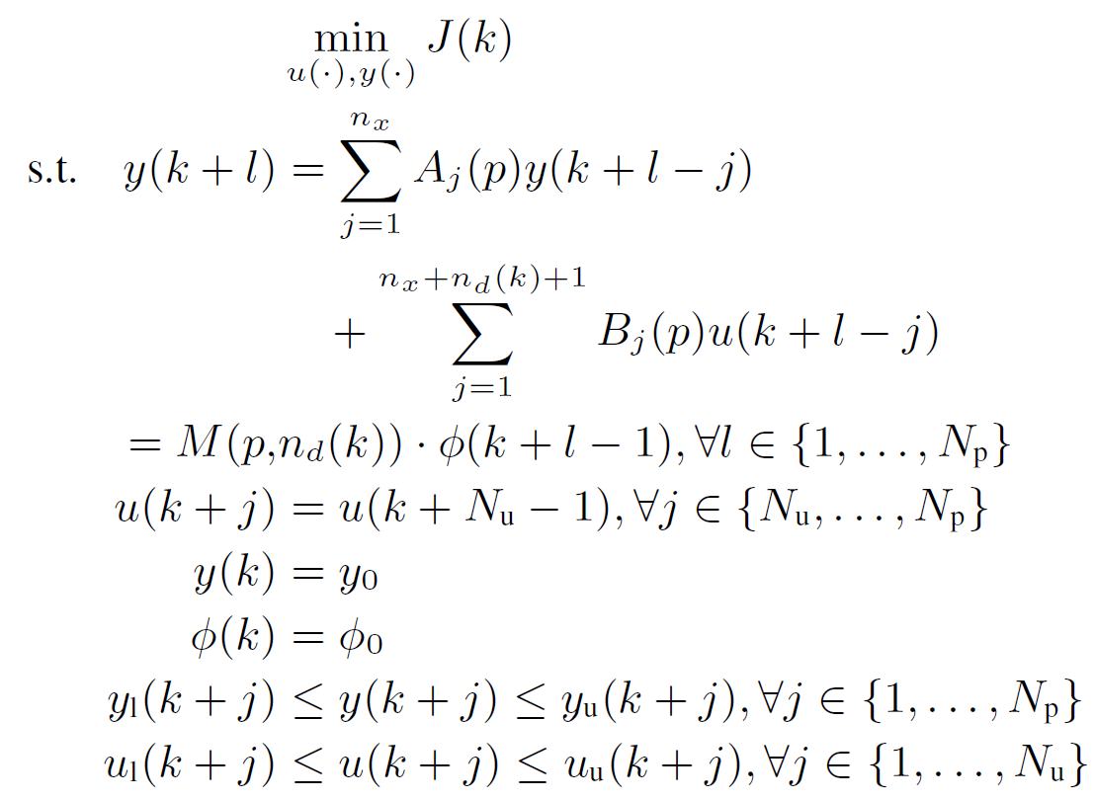
MPC formulation
Optimization problem formulation
Penalise output tracking error
Penalise deviation of inputs from steady-state targets
Stack of known past sequence of outputs and inputs
$$φ\left(k\right)={\left[y^{T}\left(k\right),y^{T}\left(k−1\right),⋯,y^{T}\left(k−n_{x}\right), u^{T}\left(k−1\right),u^{T}\left(k−2\right),…,u^{⊤}\left(k−n_{x}−n_{d}\left(k\right)−1\right)\right]}^{T}$$
$N_{p}(k)$: Prediction horizon; determines the #decision variables
$N_{u}$: Control horizon; determines the #decision variables
Notes:
The input sequence that is optimized is typically restricted to fewer variables for trading-off control performance with computations via the control horizon (Nu) constraint.
Note that the future values of parameters p can be incorporated as they may be known and in that case p represents p(k+l) in the LPV model.

Slide 15
Adaptive predictive control formulation
I/O model – can be derived from state-space model as well (see paper for details)
Incorporate workload variations as a variable delay in I/O model
For $j=\left\{1,…,n_{d}\right\}, B_{j}=0$.
The size of the MPC problem does not change
Tuning parameters and model parameters can all be changed at run-time
$$qy\left(k\right)=y\left(k+1\right)$$
$$q^{−1}y\left(k\right)=y(k−1)$$

Slide 16
Predictive control strategy
Adaptation with workload variations
$$k$$
$$k+1$$
$$k+2$$
$$k+3$$
$k+4$
$k+5$
$$f_{h}$$
sensing & processing
$$y(k+5)$$
$$y(k+4)$$
controller
case 1
case 3
case 2
actuation
Core 3
C
A
C
A
C
A
Core 2
C
A
C
A
C
A
...
Core 1
C
A
C
A
$$h$$
$$y(k)$$
$$y(k+1)$$
$$y(k+2)$$
...
...
$$y(k+5)$$
$$y(k+4)$$
$$y(k+3)$$

Slide 17
Predictive control strategy
$$k$$
$$k+1$$
$$k+2$$
$$k+3$$
$k+4$
$k+5$
Case 1: sensing delay is same as the previous step
n_{d} is kept constant, stack updated as usual
Case 2: sensing delay is increased by one step
Latest measurement is not available
n_{d} is incremented by 1, stack of past outputs is not updated
Case 3: sensing delay is reduced by one or more steps
Latest and past measurement(s) are available
n_{d} is reduced accordingly, stack updated iteratively with the available measurements
Adaptation with workload variations
$$f_{h}$$
$$y(k+4)$$
controller
case 1
case 3
case 2
actuation

Slide 18
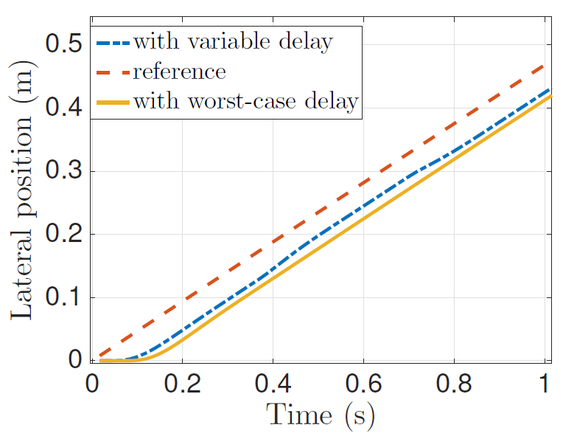
Simulation results
For an efficient MPC implementation: QP problem transformed to box-constrained least-squared problem [N. Saraf and A. Bemporad, ArXiV 2019]
Control performance evaluation
Inter-frame dependence time: f_{d} = 15 ms
System nonlinearity: v_{x} is a ramp signal
Constraints: |steering angle| = 0.5 radians
Workload variations: PERT distribution
Notes:
Specifically, the QP problem (5) is transformed to the following box-constrained
least-squares problem by eliminating equality constraints
through quadratic penalties with large weight

Slide 19
Comparison with state-of-the-art
MPC is relatively compute-intensive
Worst-case control computation time is 15x greater than LQR-based control
Still only ~6 ms for our case, assuming ~50MHz processor.
Advantages as compared to other approaches
Considers inter-frame dependencies
Modelling and considering system nonlinearities
Strictly imposing constraints on the system variables
See paper for detailed comparisons

Slide 20
Conclusions and future work
A step towards real-life adoption of IBC system
Reduce the gap between current state-of-the-art multiprocessor IBC approaches and practical control requirements
Future work:
Real-life implementation
Starting with IMACS SiL/HiL framework*
*www.es.ele.tue.nl/~dgoswami/imacs

Slide 21
S.Mohamed@tue.nl linkedin.com/in/sajidmohamed
Adaptive predictive control for pipelined multiprocessor image-based control systems considering workload variations
Sajid Mohamed¹, Nilay Saraf², Daniele Bernardini³, Dip Goswami¹, Twan Basten¹, Alberto Bemporad²
¹Eindhoven University of Technology, The Netherlands
²IMT School for Advanced Studies, Lucca, Italy
³ODYS S.r.l., Italy
This research has received partial funding from the EU’s H2020 FP under GA no 674875 (oCPS) and the ECSEL JU under GA no 783162 (FitOptiVis).

